Slide 1

Clearing Feed Generation
Group 18
Group Members:
Aditi Bornare
Gouri Somani
Mrunmayee Waykar
Rutuja Walvekar
Shruti Tanpure
Group Mentor:
Manali Wani

Slide 2

Problem Statement
Generate a feed file towards the clearing system in a specific format based on the input transactions to the system.

Slide 3
Tech Stack Used
FRONT END:
HTML, CSS, PhP
BACKEND:
Spring Boot

Slide 4
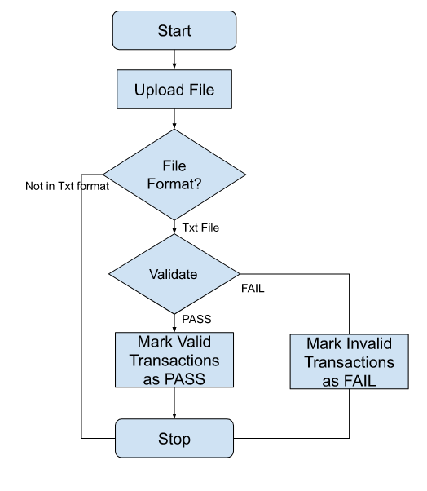
FLOW

Slide 5
Future Scope
Creating 2 different files for valid and invalid transactions

Slide 6
THANK YOU

